Slide 1


Try Crayons!
Today
For your kids ☺

Slide 2
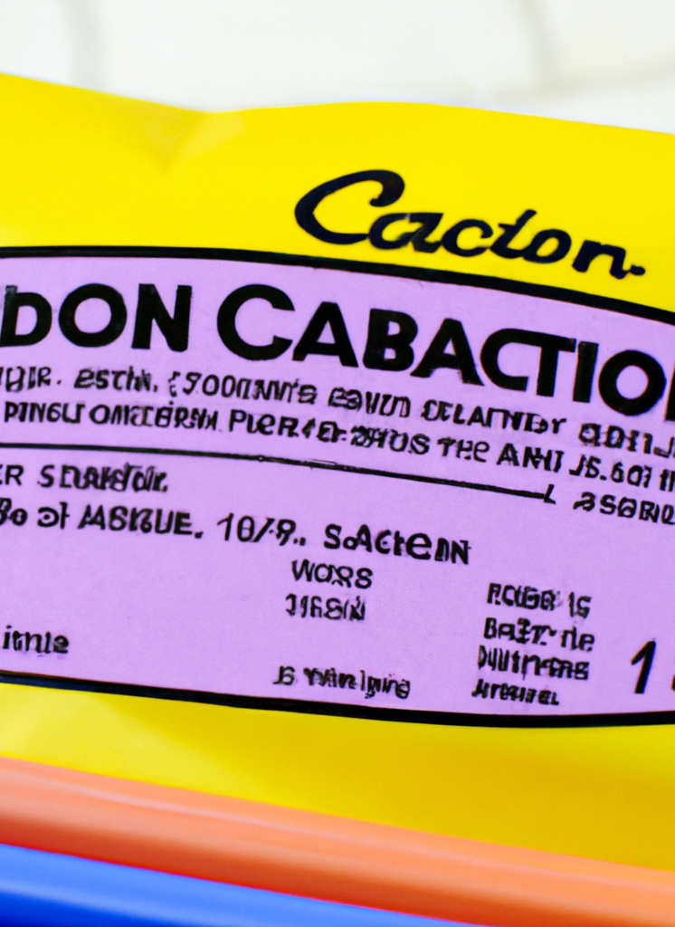
Nutritional Information
Made from a combination of edible wax, natural sweeteners, and fortified with vitamins and minerals, such as vitamin C, iron, and calcium. The crayons provide all of your nutrients and offer a sweet and fun way to fulfil your child’s diet.

Slide 3

Great for school lunches!!!!

Slide 4
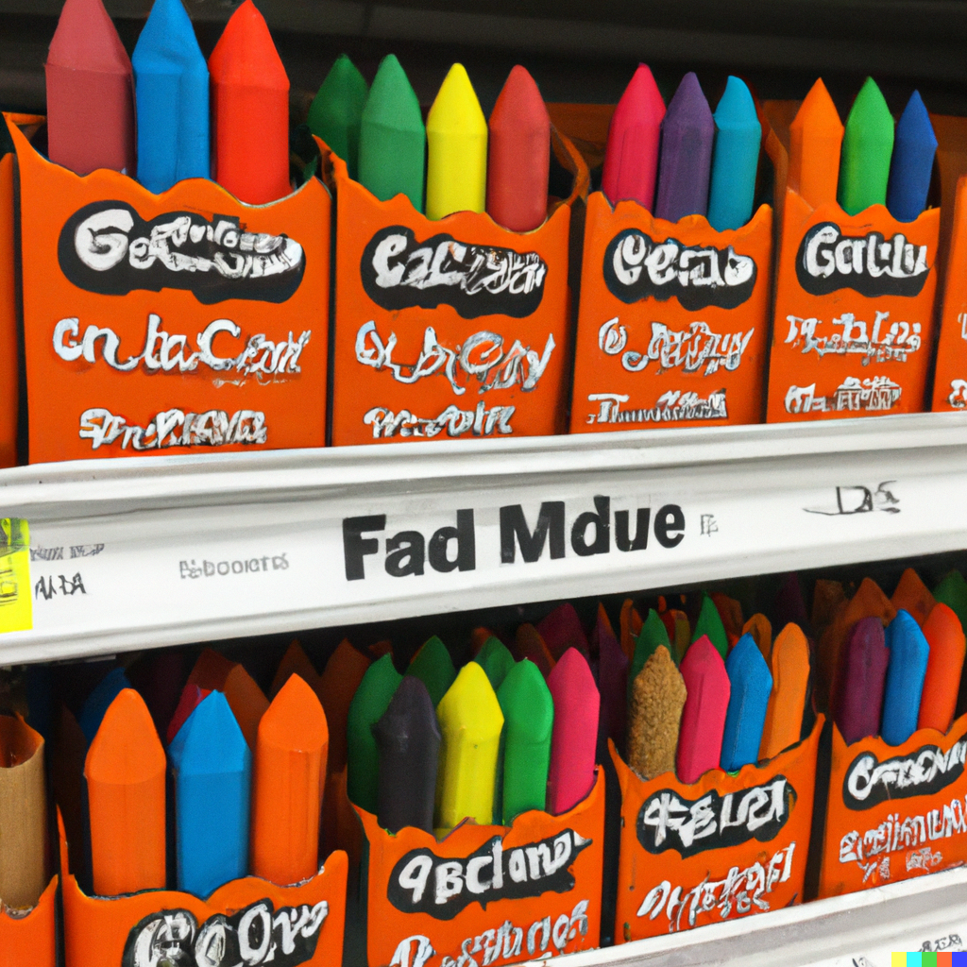
Save shopping and preparation!?!

Slide 5
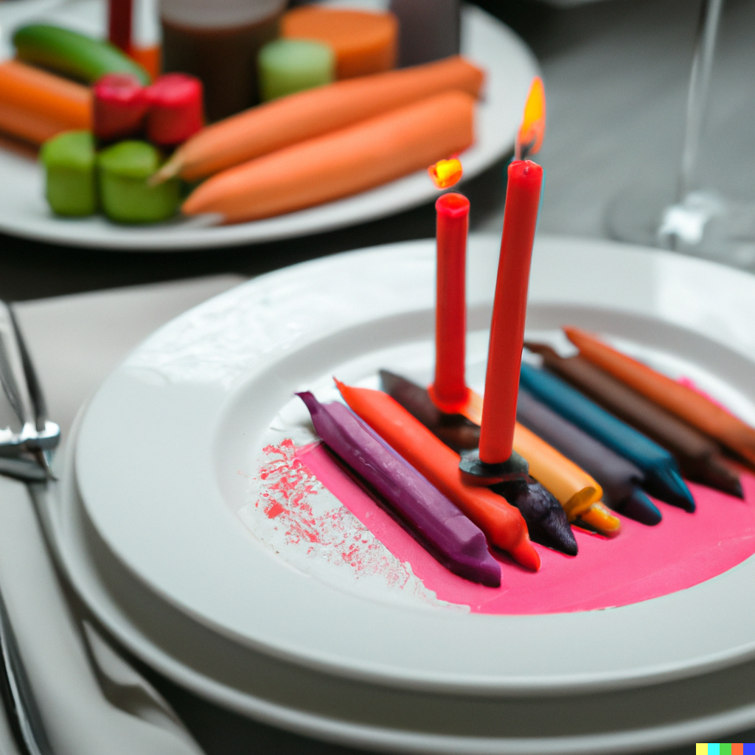
Great for a romantic meal <3 (Offer ends 13th February)

Slide 6

Approved by doctors!!!!!

Slide 7

Tested on your kids

Slide 8
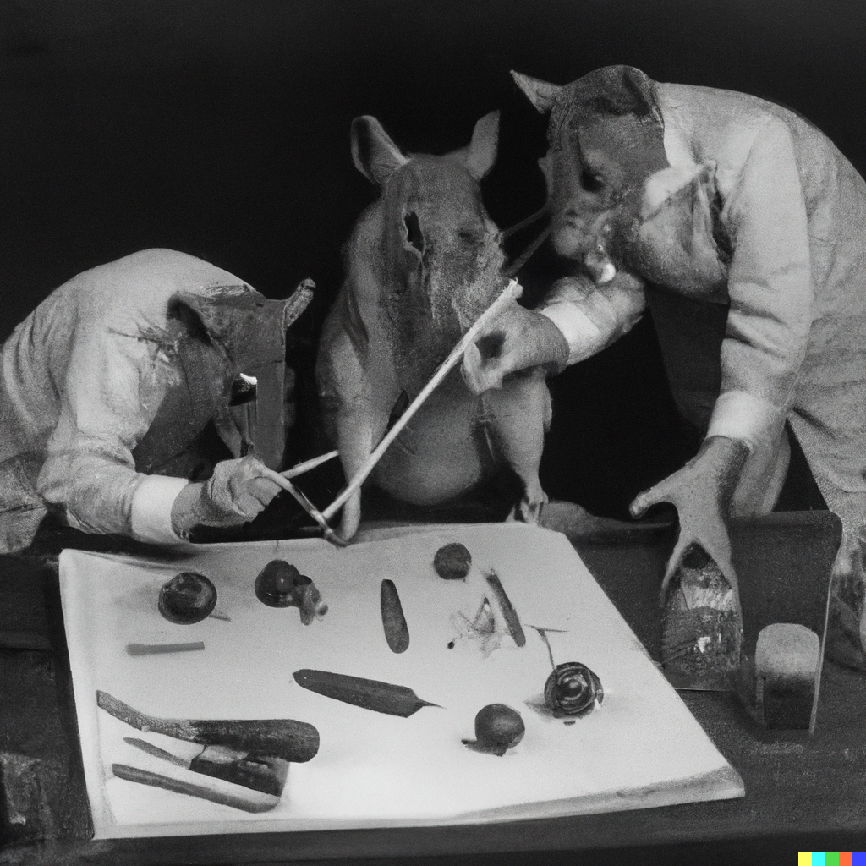
FHSRUIBFGUHSRBFHSRBGIUNBDRSIGUNBSDRUGNSERGSERHSRTEHJRTSJHRTHTJTSRJHRTFSDJRSTFHSRUIBFGUHSRBFHSRBGIUNBDRSIGUNBSDRUGNSERGSERHSRTEHJRTSJHRTHTJTSRJHRTFSDJRST
FHSRUIBFGUHSRBFHSRBGIUNBDRSIGUNBSDRUGNSERGSERHSRTEHJRTSJHRTHTJTSRJHRTFSDJRST
FHSRUIBFGUHSRBFHSRBGIUNBDRSIGUNBSDRUGNSERGSERHSRTEHJRTSJHRTHTJTSRJHRTFSDJRST
FHSRUIBFGUHSRBFHSRBGIUNBDRSIGUNBSDRUGNSERGSERHSRTEHJRTSJHRTHTJTSRJHRTFSDJRST
FHSRUIBFGUHSRBFHSRBGIUNBDRSIGUNBSDRUGNSERGSERHSRTEHJRTSJHRTHTJTSRJHRTFSDJRST
FHSRUIBFGUHSRBFHSRBGIUNBDRSIGUNBSDRUGNSERGSERHSRTEHJRTSJHRTHTJTSRJHRTFSDJRST
FHSRUIBFGUHSRBFHSRBGIUNBDRSIGUNBSDRUGNSERGSERHSRTEHJRTSJHRTHTJTSRJHRTFSDJRST
IOPYKJMPOYUTKPJHOR6EKI0RYHP0[4I8YWTJH4UIO3GBF4QBFR4UOQYURQ42JRTPQ34LTLK34QPTJKM35’HW45HWR6JHR6WJIOPYKJMPOYUTKPJHOR6EKI0RYHP0[4I8YWTJH4UIO3GBF4QBFR4UOQYURQ42JRTPQ34LTLK34QPTJKM35’HW45HWR6JHR6WJ
IOPYKJMPOYUTKPJHOR6EKI0RYHP0[4I8YWTJH4UIO3GBF4QBFR4UOQYURQ42JRTPQ34LTLK34QPTJKM35’HW45HWR6JHR6WJ
IOPYKJMPOYUTKPJHOR6EKI0RYHP0[4I8YWTJH4UIO3GBF4QBFR4UOQYURQ42JRTPQ34LTLK34QPTJKM35’HW45HWR6JHR6WJ
IOPYKJMPOYUTKPJHOR6EKI0RYHP0[4I8YWTJH4UIO3GBF4QBFR4UOQYURQ42JRTPQ34LTLK34QPTJKM35’HW45HWR6JHR6WJ
IOPYKJMPOYUTKPJHOR6EKI0RYHP0[4I8YWTJH4UIO3GBF4QBFR4UOQYURQ42JRTPQ34LTLK34QPTJKM35’HW45HWR6JHR6WJ
IOPYKJMPOYUTKPJHOR6EKI0RYHP0[4I8YWTJH4UIO3GBF4QBFR4UOQYURQ42JRTPQ34LTLK34QPTJKM35’HW45HWR6JHR6WJIOPYKJMPOYUTKPJHOR6EKI0RYHP0[4I8YWTJH4UIO3GBF4QBFR4UOQYURQ42JRTPQ34LTLK34QPTJKM35’HW45HWR6JHR6WJ
IOPYKJMPOYUTKPJHOR6EKI0RYHP0[4I8YWTJH4UIO3GBF4QBFR4UOQYURQ42JRTPQ34LTLK34QPTJKM35’HW45HWR6JHR6WJ
IOPYKJMPOYUTKPJHOR6EKI0RYHP0[4I8YWTJH4UIO3GBF4QBFR4UOQYURQ42JRTPQ34LTLK34QPTJKM35’HW45HWR6JHR6WJ
FHSRUIBFGUHSRBFHSRBGIUNBDRSIGUNBSDRUGNSERGSERHSRTEHJRTSJHRTHTJTSRJHRTFSDJRSTFHSRUIBFGUHSRBFHSRBGIUNBDRSIGUNBSDRUGNSERGSERHSRTEHJRTSJHRTHTJTSRJHRTFSDJRST
FHSRUIBFGUHSRBFHSRBGIUNBDRSIGUNBSDRUGNSERGSERHSRTEHJRTSJHRTHTJTSRJHRTFSDJRST
FHSRUIBFGUHSRBFHSRBGIUNBDRSIGUNBSDRUGNSERGSERHSRTEHJRTSJHRTHTJTSRJHRTFSDJRST
FHSRUIBFGUHSRBFHSRBGIUNBDRSIGUNBSDRUGNSERGSERHSRTEHJRTSJHRTHTJTSRJHRTFSDJRST
FHSRUIBFGUHSRBFHSRBGIUNBDRSIGUNBSDRUGNSERGSERHSRTEHJRTSJHRTHTJTSRJHRTFSDJRST
FHSRUIBFGUHSRBFHSRBGIUNBDRSIGUNBSDRUGNSERGSERHSRTEHJRTSJHRTHTJTSRJHRTFSDJRST
FHSRUIBFGUHSRBFHSRBGIUNBDRSIGUNBSDRUGNSERGSERHSRTEHJRTSJHRTHTJTSRJHRTFSDJRST
IOPYKJMPOYUTKPJHOR6EKI0RYHP0[4I8YWTJH4UIO3GBF4QBFR4UOQYURQ42JRTPQ34LTLK34QPTJKM35’HW45HWR6JHR6WJIOPYKJMPOYUTKPJHOR6EKI0RYHP0[4I8YWTJH4UIO3GBF4QBFR4UOQYURQ42JRTPQ34LTLK34QPTJKM35’HW45HWR6JHR6WJ
IOPYKJMPOYUTKPJHOR6EKI0RYHP0[4I8YWTJH4UIO3GBF4QBFR4UOQYURQ42JRTPQ34LTLK34QPTJKM35’HW45HWR6JHR6WJ
IOPYKJMPOYUTKPJHOR6EKI0RYHP0[4I8YWTJH4UIO3GBF4QBFR4UOQYURQ42JRTPQ34LTLK34QPTJKM35’HW45HWR6JHR6WJ
IOPYKJMPOYUTKPJHOR6EKI0RYHP0[4I8YWTJH4UIO3GBF4QBFR4UOQYURQ42JRTPQ34LTLK34QPTJKM35’HW45HWR6JHR6WJ
IOPYKJMPOYUTKPJHOR6EKI0RYHP0[4I8YWTJH4UIO3GBF4QBFR4UOQYURQ42JRTPQ34LTLK34QPTJKM35’HW45HWR6JHR6WJ
IOPYKJMPOYUTKPJHOR6EKI0RYHP0[4I8YWTJH4UIO3GBF4QBFR4UOQYURQ42JRTPQ34LTLK34QPTJKM35’HW45HWR6JHR6WJIOPYKJMPOYUTKPJHOR6EKI0RYHP0[4I8YWTJH4UIO3GBF4QBFR4UOQYURQ42JRTPQ34LTLK34QPTJKM35’HW45HWR6JHR6WJ
IOPYKJMPOYUTKPJHOR6EKI0RYHP0[4I8YWTJH4UIO3GBF4QBFR4UOQYURQ42JRTPQ34LTLK34QPTJKM35’HW45HWR6JHR6WJ
IOPYKJMPOYUTKPJHOR6EKI0RYHP0[4I8YWTJH4UIO3GBF4QBFR4UOQYURQ42JRTPQ34LTLK34QPTJKM35’HW45HWR6JHR6WJ
[CONFIDENTIAL]

Slide 9
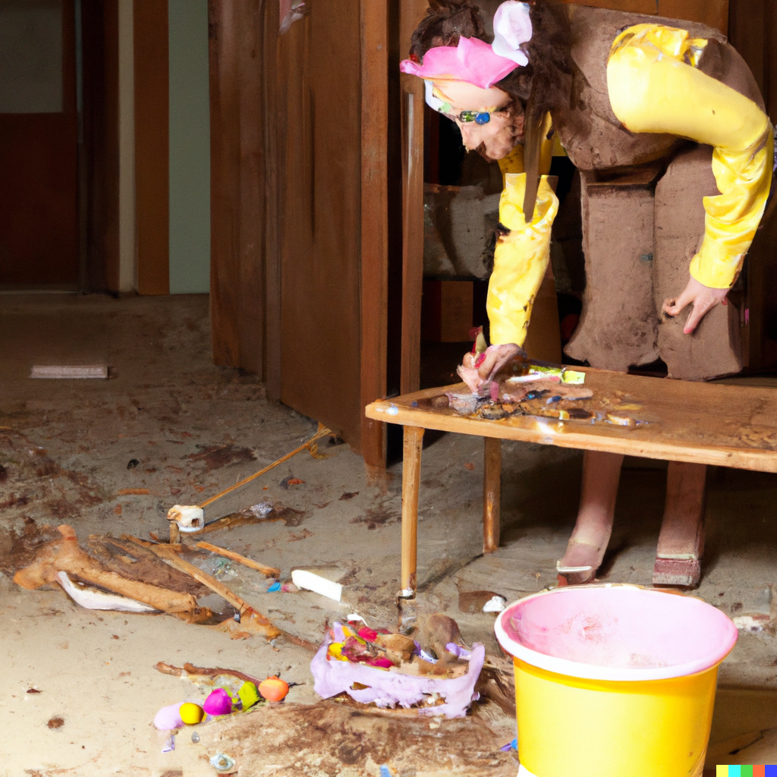
They last forever! Perfect for a rainy day (Nuclear Winter) ☹ Note: Only durable in conditions > 200 Roentgen

Slide 10
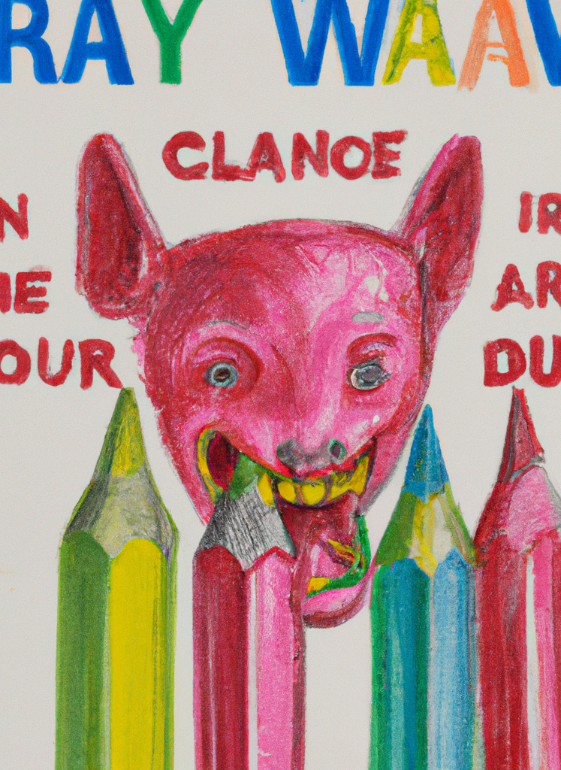
Come try crayon now
Flavours:
Orange – Carrots
Blue – Blueberries
Brown – Beef
Green – Apple
Purple – Blackberry
Red – Strawberry
Yellow – Banana
DISCLAIMER: It is important to note that while some crayons are labeled as "edible," they are not intended to be part of a regular diet, and consuming them can still pose health risks. Even if the crayons are specifically made to be eaten, there are potential safety risks that should be considered.
Eating an edible crayon can still cause choking, particularly in young children or those with swallowing difficulties. Additionally, consuming large amounts of any non-food item, including edible crayons, can cause gastrointestinal distress, such as nausea, vomiting, and abdominal pain. Edible crayons may also contain allergens, such as dairy or soy, which could cause an allergic reaction in some individuals.
Furthermore, the safety of consuming edible crayons over the long term is unknown, and there may be potential health risks associated with repeated ingestion of non-food items, even if they are designed to be eaten.
Therefore, it is important to use caution and common sense when considering consuming edible crayons or any other non-food item. It is always recommended to consult with a licensed healthcare professional or a registered dietitian before making any significant changes to your diet.

